Slide 1
Node.JS & Express.Js
Trinidad Padilla Jr
Multiverse: technical Curriculum Writer Take Home

Slide 2
Objectives:
Understand what Node.js & Express are on a high-level
Learn practical use cases for both Node.js & Express
Understand basic routing & how to setup routes in Node.js
Save our content within both a local and remote repository

Slide 3
Goals:
1) Installs & initializations: npm, inits, nodemon, GitHub repo, Express
2) Import & invoke express module
3) Define and create middleware basic functions
4) Carry out basic routing to display a message such as: “Hello World!”
5) Implement Node.js server.listen( ) method & fire up an express server

Slide 4



What is Node.JS?
According to nodejs.org: “As an asynchronous event-driven JavaScript runtime, Node.js is designed to build scalable network applications. “
It’s a back-end JS runtime environment that runs on V8 engine and executes JS code outside a web browser -> we’re able to create sever-side scripting / run scripts server-side to make dynamic web page content before the page is sent to the user’s web browser

Slide 5
What is Express?
Express = node.js framework for creating web servers and APIs.
You can use it to create powerful applications (e.g. e-commerce apps, wikis, etc.)

Slide 6

BUT WHAT DOES THAT MEAN!?

Slide 7

Express.js = express food service
Imagine you just purchased a restaurant and are looking to hire a general manager – the person who will create and handle the processes & day-to-day to keep customers happy and ensure everything operates smoothly
We’ll use this analogy to explain implementation of Express!

Slide 8
Initial SetuP
Before we dig into the main application, we have some installs & initializations to take care of
Setup:
1) Create a new npm package: ‘npm init –y’
2) Create an empty Git repository by entering the following command on the CLI: ` git init `
3) Add your file contents and stage for a commit (captures a snapshot of the project's currently staged changes): `git commit -m "Write a descriptive, short note of your file changes here" `
4) Assuming your GitHub repo has been established, navigate to your GitHub account at Github.com and create a remote repository called 'express_setup’
5) Return to the CLI and attach your remote repository (repo) by entering the following command : `git remote add origin https://github.com/YOUR_USER_NAME/express_setup.git `
6) Push your local changes to the remote repo: ` git push –u origin main`

Slide 9

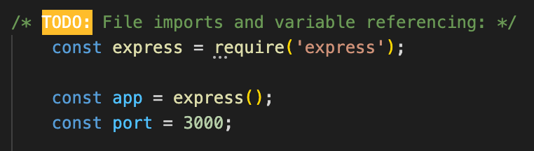
Step 1: Hiring a manager (require statements)
Recall in this example that you are a restaurant owner – you need to hire a manager to run the day-to-day operations of the restaurant
Express is the manager
Setup:
1) Install express, our web-server with the following command in the CLI: ` npm I express`
2) Create a file in your IDE called ‘index.js’ -> this is where we’ll be setting up our server
3) We have to Declare a variable to reference the port we wish to host our server on, do so now. We also have to import the express module using the 'require' keyword **HINT: It may be a good idea to save it in a variable...**
4) Invoke the express server once it is imported (require). Reference the invocation in a variable called 'app'

Slide 10
Your Turn!
Following the guidelines outlined in the previous slide, require and instantiate an express module as well as a Port to host it.

Slide 11

But First…
What are some typical routines that occur in a restaurant!?

Slide 12

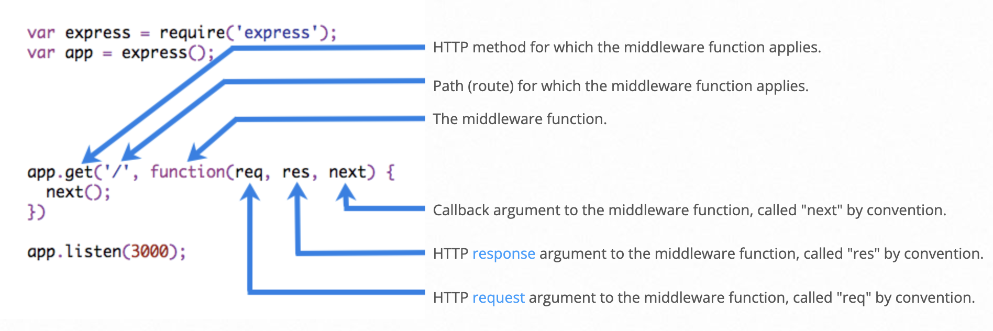
Step 2: Restaurant Decisions (middleware)
E.G. Host seats new guests, waiter takes orders, etc.
In each scenario, we have checks to run before we can execute an action (e.g. Are customers wearing clothes? If not, then we can’t seat them.)
Express is similar. We’ll want to validate whether requests have met certain criteria in order to proceed. For example, do they have an account? Correct credentials?
Middleware – functions that allow you to take action on incoming requests and modify it before sending back a response

Slide 13
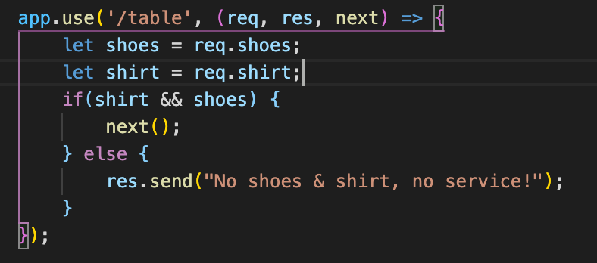
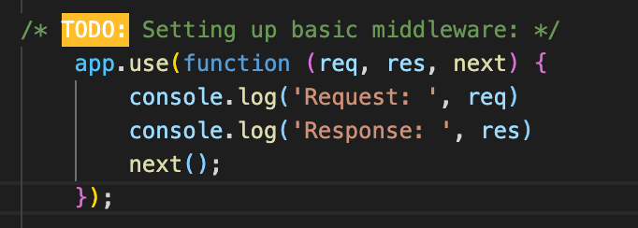
Step 2: (continued…)
app.use() -> rules that get applied for the upcoming routes / mounts function at the specified path
req -> a request object; represents HTTP request and has properties for the request query string, body, etc…
res -> a response object; represents HTTP response that an Express app sends when it gets an HTTP request
next() passes control to the next middleware function, else the request is left hanging
E.g. When a customer enters a restaurant, we have to make sure they are fully clothed before we assist them. In the first example (Fig. 1), we utilize the .use() method on the /table route, passing in our req, res, and next arguments. The next() only fires if our shoes and shirt variables output a Boolean (true), else we send a message to the client

Slide 14
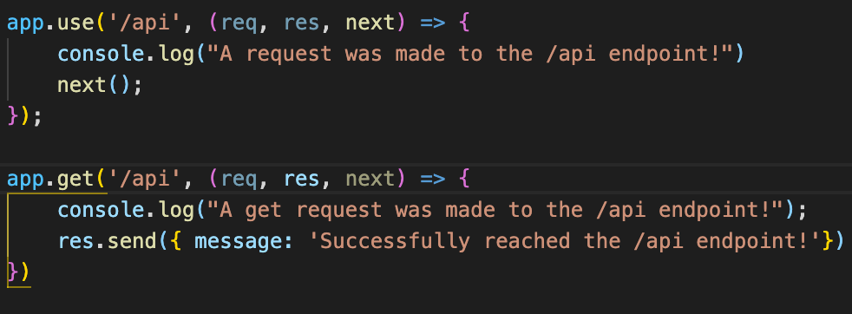
Basic Routing
Routing refers to determining how an application responds to a client request to a particular endpoint, which

Slide 15
How will I be assessed?
Final assignment successfully committed & pushed to GitHub repository
Code is ‘clean’ -> no unnecessary comments or unused code
Successfully able to display the text “Hello World!” or any relevant message to http://localhost:3000/

Slide 16
Additional Readings & Resources
{ Links to Node.js & express documentation}
{ Links to w3 school & mdn }

